Slide 1
Cloud Computing - Mini Project on
URL CONVERSION APPLICATION
Group No. - 8
2105340 - Vura Surya Suprathik
2105359 - Arpita Pal
2105397 - Raj Nandani

Slide 2
Content
Introduction
Literature Survey
Problem Definition
Objectives
Methodology
Conclusion
References

Slide 3

Introduction
In today's interconnected digital world, URL conversion applications play a crucial role in overcoming various challenges encountered while navigating the internet. These applications address issues such as incompatible formats, device limitations, and security risks, making them indispensable tools for users. One of their key functions is transforming mobile app URLs into web-viewable formats, enabling access to content designed for mobile applications on devices lacking smartphone or tablet capabilities. Additionally, URL converters tackle format incompatibilities by converting content presented in formats like Flash into more accessible alternatives like HTML or text. Moreover, these applications analyze security risks associated with shortened URLs commonly used on social media platforms, helping users identify and avoid potentially malicious websites. By enhancing accessibility and security, URL conversion applications empower users to navigate the internet confidently and securely, regardless of their technological expertise or device capabilities.

Slide 4
Literature Survey
Name | Paper | Method Used | Tools Used | Explanation
Cloud Based URL shortening | Sukshma - A URL Shortening Service Project Rohit Sankhala, Manan Kharbanda, Ankit Yadav, Pardeep Suthar, Parampreet Kaur. | SQLite database engine for the database operations | 1. Framework 2. Database- engine 3. Data Flow Architecture | In this paper, we studied a brief overview of how the URL shortening service works. The proposed shortening has features such as, Putting the domain name in the shortened URL that gives the user trust to use the service, providing the user with the option of editing the URL when needed, maintaining the record of shortened URLs and their data.
 | Shortening URLs with shorturl Berube, David | 1.Shorturl Library 2.Integration with Shortening Services | 1. Primary Tool: shorturl Library (Ruby) 2. External URL Shortening Services. | This paper likely catered to developers working with e-commerce or web applications in the late 2000s. It would have provided them with a tool (the "shorturl" library) to simplify interactions with popular URL shortening services at that time.
 | Security Threats of URL Shortening: A User’s Perspective Le-Khac, Nhien-An & Kechadi, Tahar. | 1. User Survey Participants 2.Survey Design | 1. Survey Software 2. Data Analysis Software | This research aimed to understand how users perceive the security risks of URL shortening and their level of awareness about potential threats. The findings from the study could be valuable in raising awareness about URL shortening security and potentially informing the development of safer shortening services or user education initiatives.

Slide 5
Literature Survey
Name | Paper | Method Used | Tools Used | Explanation
Healthcare Data Sharing with Encrypted URLs | Secure Multiparty computation enabled E- Healthcare system with Homomorphic encryption Kumar, A & Sujith, Mogalapalli & Sai, Kosuri & Rajesh, Galla & Yashwanth, Devulapalli. | Secure Multiparty Computation (SMC) , Homomorphic Encryption | Libraries/ Frameworks such as SEAL and HElib | This paper presents a promising approach for secure healthcare data sharing. While there are computational challenges, advancements in cryptography and computing power can lead to more efficient implementations in the future.
 | Intrusion Detection for Encrypted Web Accesses A. Yamada, Y. Miyake, K. Takemori, A. Studer and A. Perrig | Data Analysis Building a Baseline Machine Learning | Data Collection Software , Data Analysis Tools | The paper aims to develop a system that can detect intrusions (malicious attempts to access the web server) even when the traffic is encrypted. By analyzing characteristics like data size and timing patterns, the system can identify unusual activities that deviate from normal user behavior.
 | Secure-aware and privacy-preserving electronic health record searching in cloud environment Wang X, Zhang A, Xie X, Ye X. | 1.Data Encryption 2.Privacy-Preserving Techniques | Cryptographic Libraries , Development Environment | The paper aims to develop a secure and privacy-preserving EHR search system for cloud environments. By using encryption and potentially additional privacy techniques, the system allows authorized users to search for relevant medical information without compromising patient data confidentiality.

Slide 6
Literature Survey
Name | Paper | Method Used | Tools Used | Explanation
E-commerce Integration for URL Shortening | Using URL Shorteners to Compare Phishing and Malware Attacks Page, Sophie & Jourdan, Guy-Vincent & Bochmann, Gregor & Flood, Jason & Onut, Iosif-Viorel. | Data Collection , Data Analysis , Comparison and Insights | E.g.,1.Data Source Leverage:API, public Data Feeds3.Data Analysis Techniques:Statistical Software, Data Visualization Tools | The paper "Using URL Shorteners to Compare Phishing and Malware Attacks" by the Anti-Phishing Working Group (APWG) investigates how attackers utilize URL shortening services differently for phishing and malware attacks.Overall, the paper sheds light on how attackers leverage URL shorteners differently for phishing and malware attacks. This knowledge can be valuable for improving cybersecurity measures and hindering malicious activities.
 | The impact of customer behavior on marketing automation in e-commerce industry Nguyen, Thi Thuy Linh, and Thi Thuy Trang Mai. | 1.Marketing automation platform data 2. Surveys and User Research | E.g., E-commerce platform analytics tools , Data analysis software | The researchers aim to understand how to use customer behavior data to improve marketing automation strategies in e-commerce. This can help online stores target their marketing efforts more effectively and increase sales.
 | Implementation of an e-Commerce System for the Automation and Improvement of Commercial Management at a Business Level Tupia-Astoray, Anthony, and Laberiano Andrade-Arenas. | 1. Agile Framework 2. Prototype Development | E.g., Software Development Tools such as Programming Languages and Testing Tools. | The research aimed to demonstrate the feasibility and benefits of implementing an e-commerce system for automating and improving commercial management in businesses. By developing a prototype, the researchers can showcase how such a system can streamline processes, improve customer experience, and potentially increase sales.

Slide 7
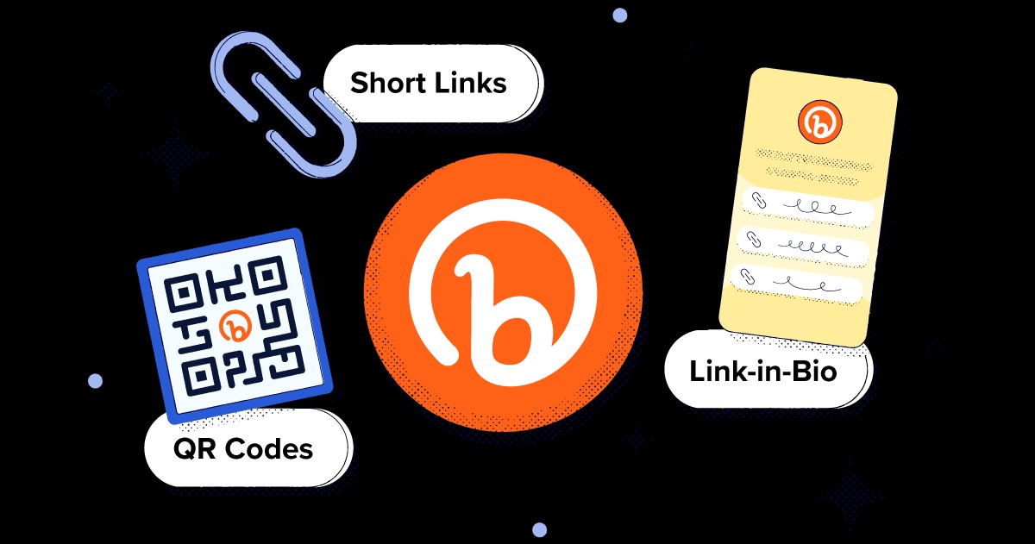
Sub - Topics - Case Studies
Case Study - 1(2105359)
Bitly's Cloud Migration: Scaling URL Shortening for the Masses
Bitly, a leading URL shortening service, experienced exponential growth in user traffic. Their on-premise infrastructure struggled to keep pace with the increasing demand. To ensure scalability, reliability, and agility, Bitly undertook a strategic cloud migration journey.
Bitly's successful cloud migration demonstrates
the transformative power of cloud computing for
high-growth businesses. By leveraging the scalability,
performance, and cost-efficiency of cloud platforms,
Bitly ensured a reliable and adaptable infrastructure for
URL shortening services, enabling them to cater to a
massive user base and drive innovation in the future.

Slide 8

Case Study - 2(2105340)
Secure Data Sharing with Encrypted URLs at Mercy General Hospital
Mercy General Hospital, a leading healthcare provider in the region,
recognizes the importance of secure data sharing for improved patient care.
However, traditional methods of sharing patient data, like faxing or email,
raise concerns about security and HIPAA compliance. To address these
challenges,Mercy General is exploring the implementation of Encrypted URLs
(EURLs) for secure data exchange.
By implementing EURLs, Mercy General Hospital can achieve secure and efficient data sharing, leading to improved patient care coordination, enhanced data security, and stronger HIPAA compliance. The successful adoption of EURLs requires careful planning, collaboration with industry partners, and ongoing user education.

Slide 9
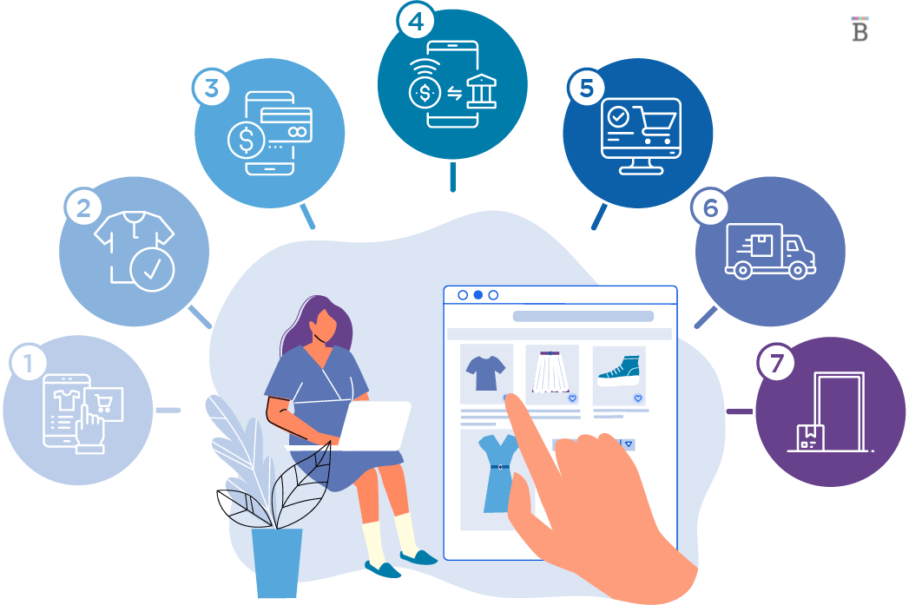
Case Study - 3(2105397)
Acme Corporation and E-commerce Integration for URL Shortening
Acme Corporation, a large e-commerce company, faced challenges with managing long and complex product URLs on their marketing materials and social media posts. These lengthy URLs were not only visually unappealing but also limited the available character count on platforms like Twitter.
This case study demonstrates how cloud-based URL shortening services can offer significant benefits to businesses:
Improved user experience with shorter, more manageable URLs.
Enhanced brand recognition and trust through custom domain names.
Valuable data and insights for data-driven marketing decisions.
Increased efficiency and reduced manual effort for marketing teams.
Cost-effective and scalable solution that adapts to business needs.

Slide 10
Problem Definition(2105359)
Cloud Based URL shortening:
The current landscape of URL sharing often involves lengthy and cumbersome website addresses. These long URLs can be difficult to remember, share, and integrate into various communication channels like social media posts, text messages, or emails. Additionally, managing and analyzing click-through data on these long URLs can be challenging.
There is a need for a cloud-based URL shortening service that offers a user-friendly and efficient solution for shortening long URLs while maintaining essential functionalities.

Slide 11
Methodology - 1
Requirement Analysis:
User Needs: Identify what users expect from the URL shortening service. This could include features like easy submission of long URLs, analytics to track click-through rates, and a user-friendly interface.
Stakeholder Requirements: Consider the requirements of stakeholders such as administrators who manage the service, developers who maintain it, and potentially advertisers or partners who may integrate with it.
System Capabilities: Assess the technical capabilities of the system, including factors like scalability, security requirements, integration with other systems, and performance considerations.

Slide 12
Methodology - 2
Design and Architecture:
Overall Architecture: Define the high-level architecture of the system, including the main components such as the URL shortening engine, database, user interface, and analytics module.
Component Design: Detail the design of individual components, specifying their responsibilities, interfaces, and interactions with other components.
Technology Selection: Choose the appropriate technologies and frameworks for implementing each component, considering factors like scalability, security, developer familiarity, and community support.
Scalability and Performance: Design the system to be scalable and performant, ensuring that it can handle a large volume of URL shortening requests and provide timely responses to users.
Security Measures: Incorporate security measures such as input validation, encryption of sensitive data, access controls, and protection against common security threats like injection attacks and unauthorized access.

Slide 13
Methodology - 3
SQLITE database engine:
SQLite is a lightweight, self-contained, serverless database engine, making it ideal for cloud-based applications with limited resources.
Zero Configuration:
Requires minimal setup and configuration, allowing for easy deployment in cloud environments without extensive administration overhead.
Supports ACID (Atomicity, Consistency, Isolation, Durability) transactions, ensuring data integrity and reliability in cloud-based URL shortening operations.
everaging SQLite as the database engine for cloud-based URL shortening offers a lightweight, efficient, and easily deployable solution with transactional support, concurrency control, and portability, making it well-suited for cloud computing environments

Slide 14
Problem Definition(2105340)
Healthcare Data Sharing with Encrypted URLs
Securely sharing sensitive healthcare data is crucial in the medical field, but traditional methods often pose challenges:
•Unsecured File Sharing: Sharing healthcare data through email or file transfer services can be risky due to potential breaches or unauthorized access.
•Limited Control: Once data is shared, senders lose control over who can access it and how it's used.
•Compliance Issues: Data sharing needs to comply with regulations like HIPAA (Health Insurance Portability and Accountability Act) to protect patient privacy.
These issues highlight the need for a more secure and controlled method for healthcare data sharing. URL conversion applications can play a vital role in addressing this challenge.

Slide 15
Methodology - 1
Implementation and Performance Evaluation:
Implementation builds the system using your chosen SMPC protocol and HE scheme. This involves:
Picking the programming tools and environment.
Implementing the HE scheme to encrypt medical data.
Integrating the SMPC protocol for secure computations on encrypted data.
Designing user interfaces and functionalities for patients, doctors, and the server.
Performance Evaluation measures how well the system works. This involves:
Defining how well the system performs (speed, accuracy).
Running tests with different data sizes and usage patterns.
Analyzing the results to see if the system is efficient and accurate.
Comparing it to existing systems (if applicable).

Slide 16
Methodology - 2
Secure Multiparty Computation (SMC):
Confidential Computation: SMC allows multiple parties to jointly compute a function over their private inputs while keeping those inputs confidential.
Privacy-Preserving: SMC ensures that sensitive healthcare data remains encrypted during computation, protecting patient privacy.
Collaborative Analysis: Multiple healthcare entities can securely analyze encrypted data without revealing the actual data to any single party.
Security against Malicious Participants: SMC protocols ensure correctness even if some parties are malicious or compromised.
Application: SMC can be applied to perform computations on encrypted healthcare data, such as statistical analysis, machine learning algorithms, and decision-making processes.

Slide 17
Methodology - 3
Homomorphic Encryption:
Computation on Encrypted Data: Homomorphic encryption enables computations to be performed directly on encrypted data without decryption, preserving data privacy.
End-to-End Encryption: Healthcare data can be encrypted using homomorphic encryption before sharing, ensuring confidentiality throughout the data sharing process.
Data Integrity: Homomorphic encryption ensures that the results of computations performed on encrypted data are correct, even though the data remains encrypted.
Secure Outsourcing: Healthcare organizations can securely outsource data processing tasks to third-party service providers while maintaining data confidentiality.
Application: Homomorphic encryption can be applied to encrypt URLs containing healthcare data, ensuring that sensitive information remains confidential during transmission and processing.

Slide 18
Problem Definition(2105397)
E-commerce Integration for URL Shortening:
In the context of integrating e-commerce functionality with URL shortening services in cloud computing environments, the proliferation of malware presents a significant challenge. The use of shortened URLs for promotional campaigns, product links, and user engagement exposes e-commerce platforms and their users to the risk of malware attacks. Malicious actors exploit URL shortening services to conceal harmful links, leading to potential security breaches, data theft, and financial losses. Despite advancements in cloud security measures, the dynamic nature of malware threats poses an ongoing concern for e-commerce businesses seeking to leverage URL shortening for marketing and sales activities.

Slide 19
Methodology - 1
Data Collection:
This step involves gathering relevant data pertaining to URL shortening and e-commerce integration.
Researchers collect data from various sources such as URL shortening services, e-commerce platforms, and external databases.
The data collected may include information about the usage of shortened URLs in e-commerce transactions, user engagement metrics, click-through rates, conversion rates, and other relevant variables.
Data collection methods may include web scraping, API integration with URL shortening services and e-commerce platforms, surveys, and interviews with stakeholders.

Slide 20
Methodology - 2
Data Analysis:
Once the data is collected, researchers analyze it to identify patterns, trends, and insights related to e-commerce integration for URL shortening.
Various analytical techniques such as descriptive statistics, regression analysis, clustering, and trend analysis may be employed.
Data analysis aims to uncover correlations between different variables, understand user behavior, and identify factors influencing the effectiveness of URL shortening in e-commerce contexts.
Researchers may also use data visualization techniques such as charts, graphs, and heatmaps to present findings in a visually appealing and understandable manner.

Slide 21
Methodology - 3
Comparison and Insights:
In this phase, researchers compare different aspects of e-commerce integration for URL shortening, such as performance metrics, user engagement, and conversion rates.
Insights are derived from the comparison of data collected from different sources or over different time periods.
Researchers may identify best practices, challenges, and opportunities associated with e-commerce integration for URL shortening.
Insights gained from the analysis help in understanding the impact of URL shortening on e-commerce performance, optimizing strategies, and making informed decisions for future implementations.

Slide 22
Conclusion
Cloud computing is pivotal for e-commerce, URL shortening, and healthcare data sharing. It offers scalability, cost-efficiency, and security. E-commerce benefits from on-demand resources, avoiding server costs, and ensuring smooth operations during traffic surges. URL shortening gains global accessibility, high availability, and analytics for marketing optimization. Healthcare data sharing benefits from encryption, access controls, and regulatory compliance. Cloud computing drives integration, efficiency, and security across sectors.

Slide 23
References
Hu, Mingqi, Yanli Ren, and Cien Chen. 2023. "Privacy-Preserving Medical Data-Sharing System with Symmetric Encryption Based on Blockchain" Symmetry 15, no. 5: 1010. https://doi.org/10.3390/sym15051010
Jamshidi, Pooyan & Ahmad, Aakash & Pahl, Claus. (2014). Cloud Migration Research: A Systematic Review. IEEE Transactions on Cloud Computing. 1. 142 - 157. 10.1109/TCC.2013.10.
https://www.sciencedirect.com/topics/computer-science/cloud-migration
Kumar, A & Sujith, Mogalapalli & Sai, Kosuri & Rajesh, Galla & Yashwanth, Devulapalli. (2020). Secure Multiparty computation enabled E-Healthcare system with Homomorphic encryption. IOP Conference Series: Materials Science and Engineering. 981. 022079. 10.1088/1757-899X/981/2/022079.
Page, Sophie & Jourdan, Guy-Vincent & Bochmann, Gregor & Flood, Jason & Onut, Iosif-Viorel. (2018). Using URL shorteners to compare phishing and malware attacks. 1-13. 10.1109/ECRIME.2018.8376215.
Sankhala, R., Kharbanda, M., Yadav, A., Suthar, P., & Kaur, P. (2022). Sukshma - A URL Shortening Service Project. [INTERNATIONAL JOURNAL OF CREATIVE RESEARCH THOUGHTS - IJCRT (IJCRT.ORG)].

Slide 24
Berube, David. (2007). Shortening URLs with shorturl. 10.1007/978-1-4302-0193-9_30.
Le-Khac, Nhien-An & Kechadi, Tahar. (2015). Security Threats of URL Shortening: A User’s Perspective. International Journal of Advances in Computer Networks. 3. 213. 10.7763/JACN.2015.V3.169.
A. Yamada, Y. Miyake, K. Takemori, A. Studer and A. Perrig, "Intrusion Detection for Encrypted Web Accesses," 21st International Conference on Advanced Information Networking and Applications Workshops (AINAW'07), Niagara Falls, ON, Canada, 2007, pp. 569-576, doi: 10.1109/AINAW.2007.212. keywords: {Intrusion detection;Cryptography;Timing;Data mining;Telecommunication traffic;Research and development;Laboratories;Web server;Protocols;Network servers},
Wang X, Zhang A, Xie X, Ye X. Secure-aware and privacy-preserving electronic health record searching in cloud environment. Int J Commun Syst. 2019; 32:e3925. https://doi.org/10.1002/dac.3925
Nguyen, Thi Thuy Linh, and Thi Thuy Trang Mai. "The impact of customer behavior on marketing automation in e-commerce industry." (2023).
Tupia-Astoray, Anthony, and Laberiano Andrade-Arenas. "Implementation of an e-Commerce System for the Automation and Improvement of Commercial Management at a Business Level." International Journal of Advanced Computer Science and Applications 12.1 (2021).

